Slide 1
Probability & Random Processes EE2011 Department of Electrical Engineering
NATIONAL UNIVERSITY OF COMPUTER & EMERGING SCIENCES, LAHORE CAMPUS

Slide 2





Slide 3





Slide 4






Slide 5


Slide 6
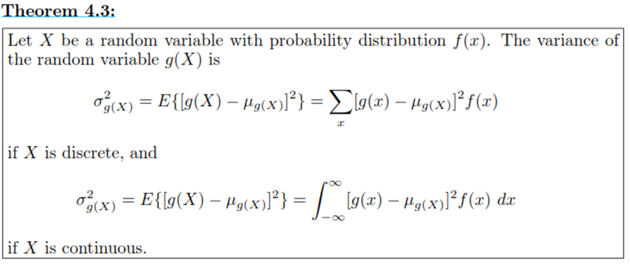

Slide 7


Slide 8





Slide 9




Slide 10

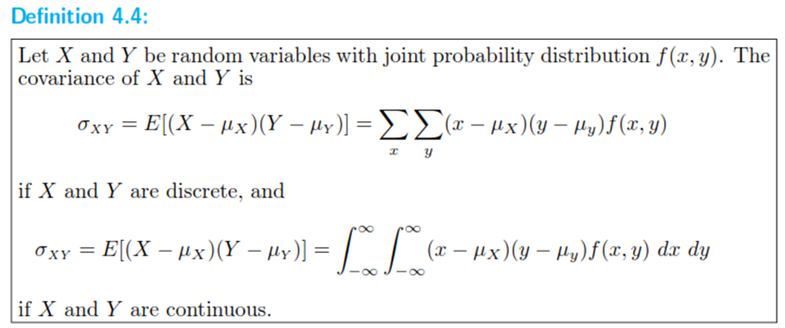

Slide 11



Slide 13




Slide 14



Slide 15

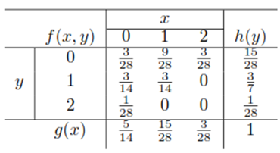

Slide 16





Slide 17







Slide 18


Slide 20





Slide 21





Slide 22


Slide 23




Slide 24

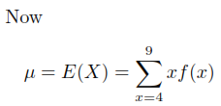


Slide 25




Slide 26




Slide 27





Slide 28





Slide 29





Slide 30


Slide 31





Slide 33





